Slide 1


Vaccination in
Post-Acute & Long-Term Care Medicine:
Preventing Disease in
Residents & Staff
Date:
Location:
Notes:
Welcome to this presentation on vaccination in post-acute and long-term care medicine. Today we'll talk about preventing disease in residents and staff.
We’ll keep this professional development in-service short. The overall goal for this session is to provide you with vaccine information that you can use at work, and as it relates to us and our families.

Slide 2

Introductions
Name
Area or role
Favorite dessert
Notes:
Let's go around the room quickly and just say your name, what area you work in or what your role is, and your favorite dessert.
I’ll start. My name is {name}; I work in {area}. My favorite dessert is {dessert}.

Slide 3
Outline
Special considerations for people who work with older adults
Vaccines that are recommended for older adults
Vaccines recommended for people who work with older adults
Frequently asked questions
Helping to make sure residents are vaccinated
Information specific to our workplace
Notes:
Here are the topics that we'll cover briefly today:
First, we'll talk about special considerations for people who work with older adults.
We'll discuss vaccines that are recommended for older adults
and touch on vaccines that are recommended for people who work with older adults.
We'll address some frequently asked questions
and talk about helping to make sure residents are vaccinated.
Then we'll wrap up with some information about vaccination in our workplace.

Slide 4
Special considerations for people (like all of us) who work with older adults
Notes:
Let's talk first about special considerations for people like all of us, who work closely with older adults.

Slide 5



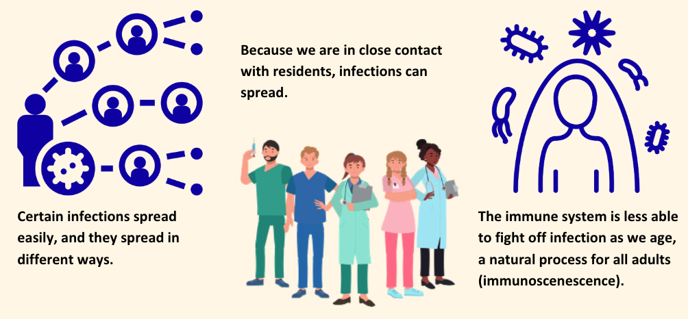
Three key considerations
Notes:
There are three key considerations:
First -- we'll talk about how certain infections spread easily and they spread in different ways.
Number 2 -- we'll touch on how, because we are in close contact with residents, infections can spread.
Then, Number 3 -- we'll say a few words about how the immune system is less able to fight off infection as we age, a natural process for all adults called immunosenescence.
(SPEAKER NOTE: for how to pronounce “immunosenescence” see https://www.youtube.com/watch?v=Rm3zn8T-Q2I )

Slide 6
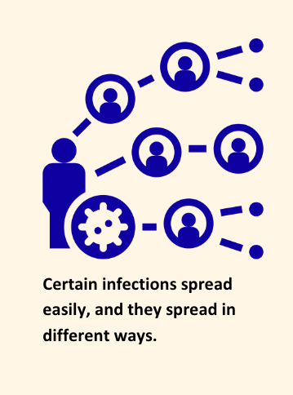
Can you think of a way that infections spread?
Notes:
So, let’s start with our first consideration: Certain infections spread easily, and they spread in different ways.
Can you think of a way that infections spread?
{SPEAKER NOTE: GIVE THEM A CHANCE TO ANSWER}

Slide 7
Some spread in blood and body fluids
(e.g., hepatitis B)
Some spread if stool contaminates surfaces
(e.g., hepatitis A)
A lot spread in droplets from the airway during talking, singing, coughing, sneezing, etc.
(e.g., flu, COVID-19, RSV,
whooping cough, strep pneumonia)
Notes:
Some infections spread in blood and body fluids – a good example is hepatitis B.
Some infections spread if stool contaminates surfaces -- hepatitis A is a perfect example of this.
A lot of germs spread in droplets from the airway during talking, singing, coughing, sneezing, etc. Flu and COVID-19 come to mind as examples. Other examples include RSV, whooping cough, and strep pneumonia.

Slide 8
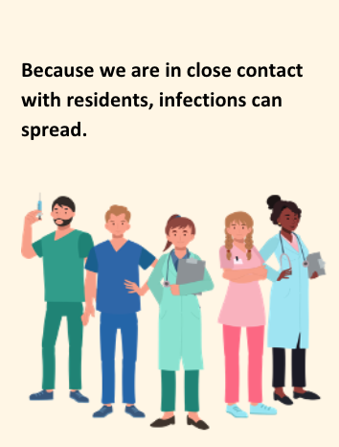
Residents
Notes:
Then, the second key consideration: We work under circumstances that make the spread of infections especially easy.
Day in and day out we are in very close contact with older adults. For this reason, we can spread germs to them, and they can spread germs to us.

Slide 9
Once infected, we can spread the germs to other residents & our coworkers.
Residents
Co-workers
Notes:
Of course, it doesn't end there. Once we are infected (even if we don’t feel sick), we can spread the germs to other residents and our coworkers. This can lead to coworkers being out sick, and that affects us all.

Slide 10
Once infected, we can spread the germs to other residents & our coworkers.
We can also spread the germs to our families.
Residents
Our Loved Ones
Co-workers
Notes:
Unfortunately, we can also spread the germs to our families, which is something many of us worry about.

Slide 11
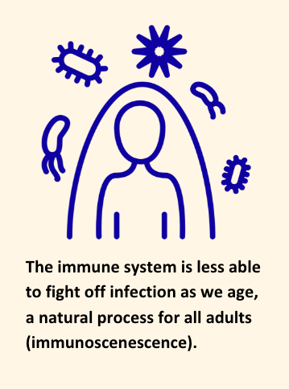
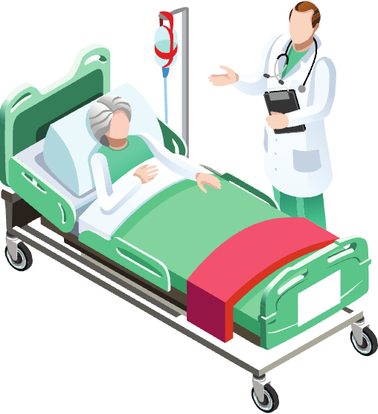
Because of this, older adults can get very sick more easily than healthy younger adults.
Notes:
The third special consideration is that the immune system is less able to fight off infection as we age, which is a natural process for all adults.
This goes for frail older adults, but even healthy older adults don't have the immune response that a young person has.
Because of this, older adults can get very sick more easily than healthy younger adults.

Slide 12
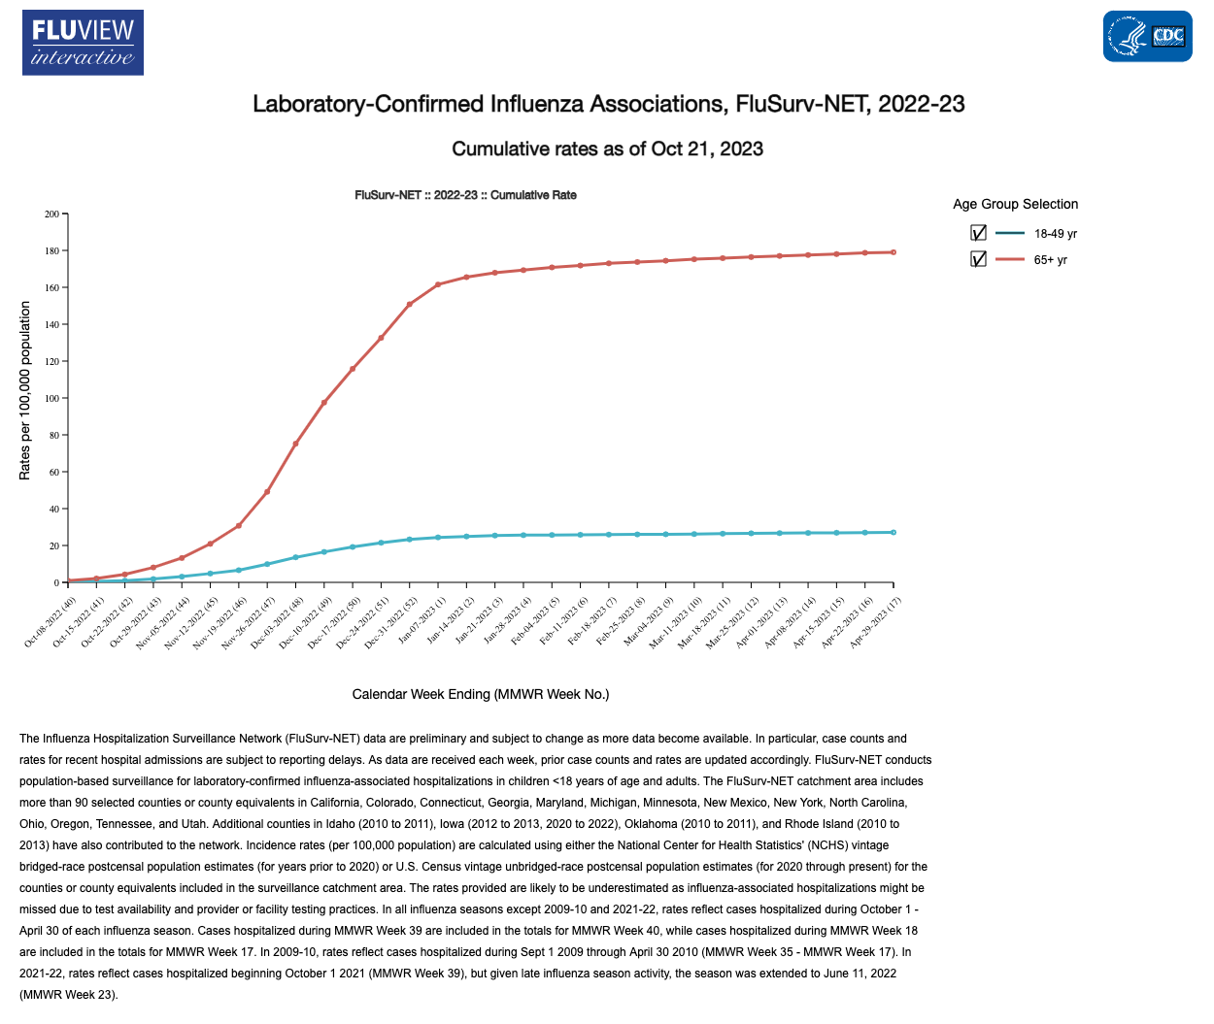
The immune system is less able
to fight off infection as we age
Cumulative U.S. rate of hospitalization for flu
from October 2022 to April 2023
Age 65+ years
Age 18-49 years
Time (from Oct 2022 to April 2023)
Notes:
Here is some evidence about this 3rd point that older adults are less able to fight off infection.
On this slide you see the rate of hospitalization for flu from October 2022 to April 2023. You see the rate of hospitalization for people aged 65 and older (in red) is much higher than for adults aged 18 to 49 years (in blue).
As with flu, older people have more complications from many of the lung infections that can be prevented by vaccines.

Slide 13
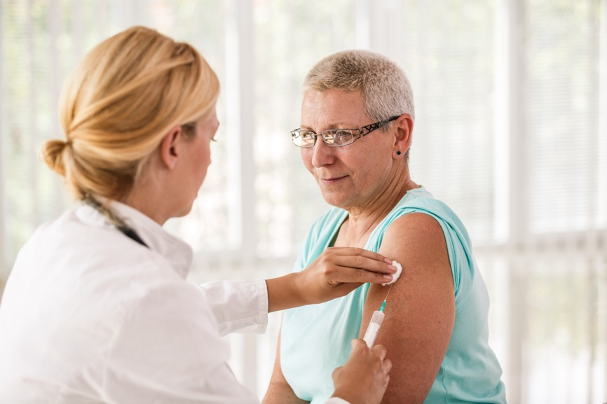
New technology for older adults: stronger flu vaccines
Fluzone® High-Dose: contains 4 times the amount of antigen as a regular flu vaccine
Flublok®: contains 3 times the amount of antigen as a regular flu vaccine (and has no egg protein)
FLUAD™: a standard dose flu vaccine with an ingredient added to help create a stronger immune response
Studies have shown these special vaccines lead to a better immune response in older adults than the usual flu vaccine.
Notes:
One way to protect older adults is use of new technology. For example, there are new, stronger flu shots recommended for older adults.
You see here: there are two high dose flu vaccines and a flu vaccine that contains an ingredient to enhance its effect.
Studies have shown these special vaccines lead to a better immune response in older adults than the usual flu vaccine.

Slide 14

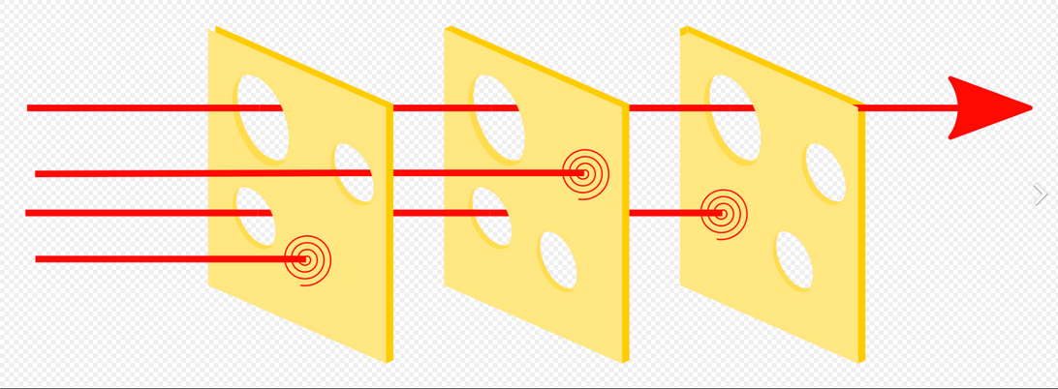
Vaccinate staff
Vaccinate residents
Good handwashing
Under the “Swiss cheese model,” each layer of protection against infection has holes. Using several layers of defense can help keep our residents better protected.
The 'holes' in one layer of defense may be covered by another layer of defense. It is still possible for the infection to “get through,” but the chances go down with each added layer of defense.
Notes:
You can think of protection against infection as a series of slices of Swiss cheese.
Under the “Swiss cheese model” each layer of protection against infection has holes. Using several layers of defense can help keep our residents better protected.
The 'holes' in one layer of defense may be covered by another layer of defense. It is still possible for the infection to “get through,” but the chances go down with each added layer of defense.
That's why --in addition to getting vaccinated ourselves -- we strive to have our residents vaccinated, and to all use good hand washing.

Slide 15

Being sick in bed can start a downhill cascade
Notes:
One more thing I want to mention: with our residents it's not just the infection itself that’s the problem.
After an older adult is sick in bed for a few days they can lose some muscle mass.
When they get up, they may be weak or dizzy. If they're hospitalized, they may even become disoriented.
Being sick in bed can start a downhill cascade that can lead to the need for a higher level of care.

Slide 16


In summary
We work in close contact with very vulnerable people, so layers of extra precautions are needed to keep them healthy.
Vaccination is an important part of the protection for all of us (including residents, co-workers, and our families).
There is so much evidence that vaccination is important that to get a CMS five-star quality rating, we must show that a high percentage of our residents are up to date on their pneumonia and flu vaccines and that a high percent of staff are up to date on their flu vaccine, too.
To see nursing homes’ ratings, go to www.medicare.gov/care-compare/?redirect=true&providerType=NursingHome
Notes:
So, in summary:
We work in close contact with very vulnerable people, so layers of extra precautions are needed to keep them healthy.
Vaccination is an important part of the protection for all of us (including residents, co-workers, and our families).
In fact, there is so much evidence that vaccination is important that to get a CMS five-star quality rating, we must show that a high percentage of our residents are up to date on their pneumonia and flu vaccines and that a high percentage of staff are up to date on their flu vaccine, too.

Slide 17
Which vaccines are recommended for older adults and what diseases are we preventing?
Notes:
Now that we know why older adults are particularly vulnerable and the potential consequences of getting sick, let's move on next to talk about which vaccines are recommended for older adults and what diseases are we preventing?

Slide 18

Discussion point:
How many vaccines can you name that are routine for older adults?
Notes:
How many vaccines can you name that are routine for older adults?
(SPEAKER NOTE: ANSWER IS ON NEXT SLIDE)

Slide 19
Overview
Routine vaccines for older adults include:
      RSV
      Flu
      COVID-19
      Strep pneumonia (pneumococcus)
      Shingles
      Tdap
Notes:
Routine vaccines for older adults include:
R.S.V. (this is a recent recommendation, and we are excited about it because of how much this virus impacts residents!)
Flu
COVID-19
Strep pneumonia also known as pneumococcus
Shingles, and
Tdap, a vaccine against tetanus, diphtheria, and pertussis. Tdap is routinely given every 10 years.
An older adult who has special health considerations – such as travel abroad -- may need additional vaccines. Today, we’ll focus just on these routine vaccines for older adults, as well as vaccines that are recommended for staff because of your increased risk of getting exposed working in this environment.

Slide 20
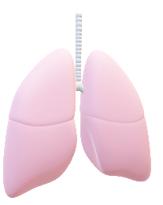
Lung disease
Routine vaccines for older adults include:
      RSV
      Flu
      COVID-19
      Strep pneumonia (pneumococcus)
      Shingles
      Tdap (pertussis is whooping cough, also a lung disease)
Notes:
You see that almost all of these germs cause to lung disease.
Strep pneumonia is a little different because it can invade the brain or bloodstream, too.
In T-dap, the “P” stands for pertussis (also known as whooping cough) which also is is a lung disease.
We'll look at each of these one at a time.

Slide 21
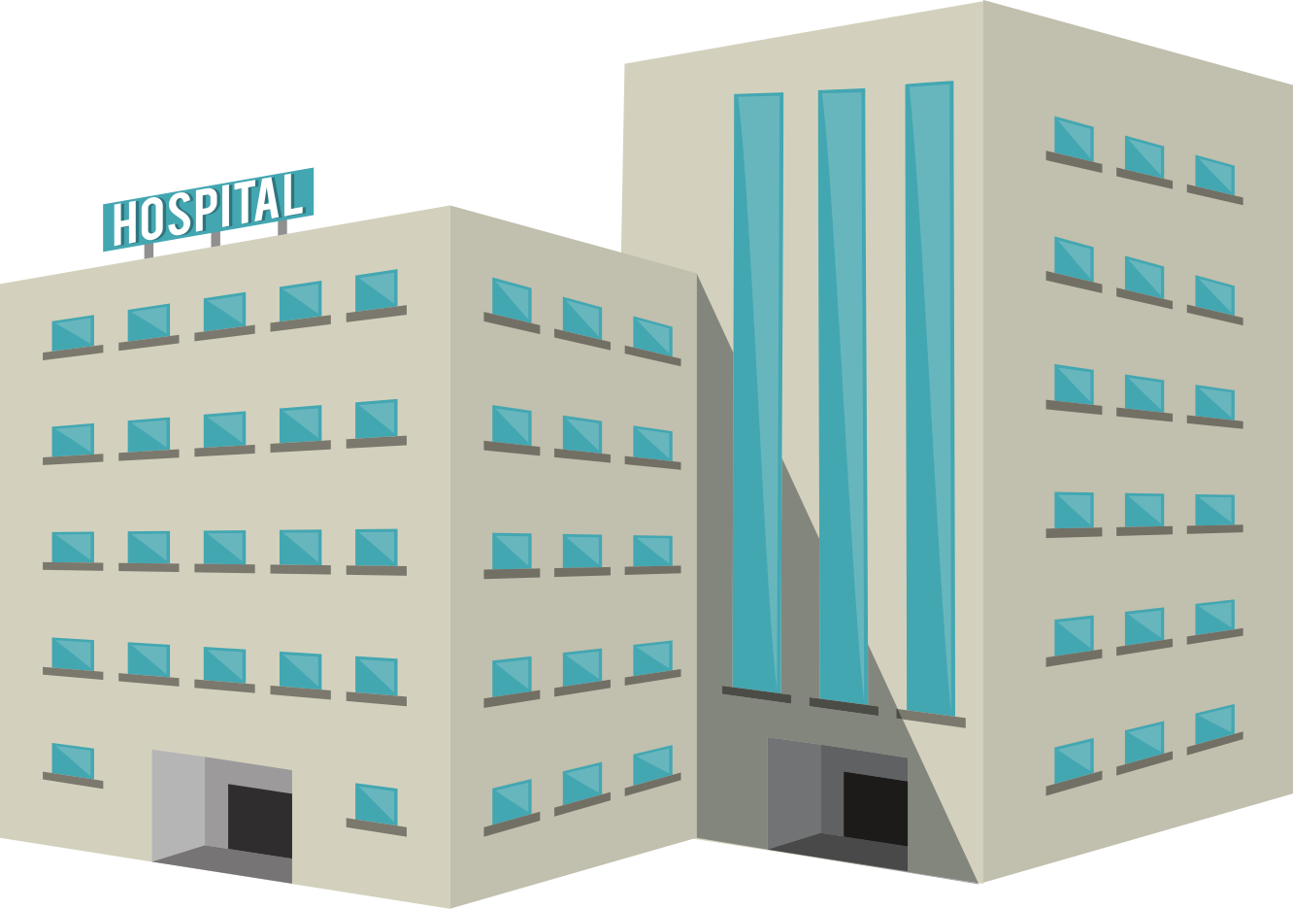
RSV
Full name: respiratory syncytial virus
Lung disease
RSV disease complications: in the U.S., in older adults
  60,000-160,000 hospitalized each year
  6,000-10,000 die each year
Treatment
  No antibiotic/antiviral
  Treat symptoms and support
  breathing & fluid intake
Notes:
The first one is R.S.V. That stands for respiratory syncytial virus.
RSV causes lung disease.
RSV is the most common reason for hospitalization of babies less than one year of age. It’s also a less recognized issue for older adults, where RSV causes 60,000 to 160,000 hospitalizations each year and
6,000 to 10,000 deaths each year.
There are no antibiotics or anti-viral medicine to treat RSV. We can only treat symptoms and support breathing and fluid intake.
SPEAKER NOTE: syncytial is pronounced sin-ˈsish-(ē-)əl https://www.merriam-webster.com/medical/syncytial

Slide 22
RSV (continued)
Adults at highest risk for severe RSV infection include adults with:
  Advanced age
  Chronic heart disease
  Chronic lung disease
  Weakened immune system
  Certain other underlying medical conditions
  And those living in nursing homes or long-term care facilities
There is a vaccine to prevent RSV and recent recommendations to consider giving everyone 60 years of age or older the vaccine.
Notes:
The adults at highest risk for severe RSV are people with advanced age,
chronic heart disease,
chronic lung disease,
weakened immune system,
certain underlying medical conditions, and
those living in nursing homes or long-term care facilities.
So, all our residents are at highest risk for RSV.
There is a vaccine to prevent RSV and recent recommendations to consider giving everyone 60 years of age or older the vaccine.

Slide 23
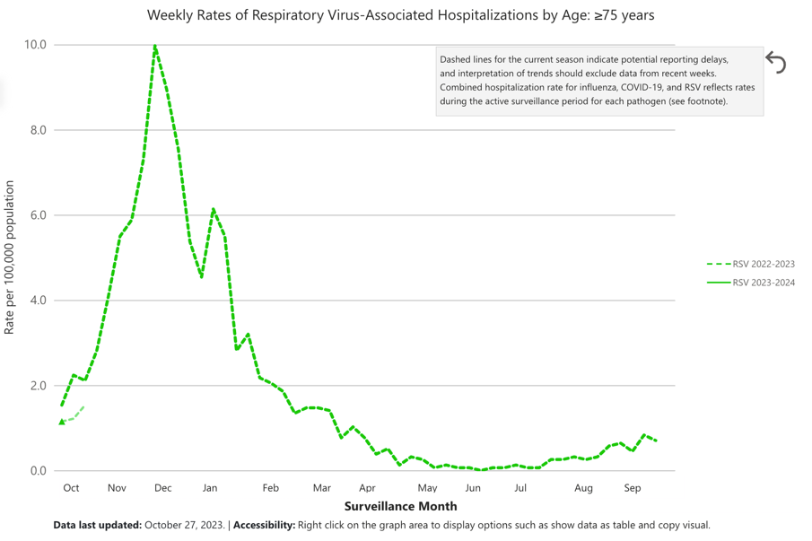
10 per 100,000
Weekly Hospitalization Rates for RSV (age 75+ years)
RSV season is about October to March in most of the U.S.
Notes:
RSV vaccine is important because it may help decrease the need for hospital care in fall and winter every year.
This slide shows you the weekly rates of hospitalization for RSV disease in people 75 years of age or older.
You see that RSV season runs from about October to March. RSV season peaks in December usually.
Last year in the U.S. at the peak of RSV season, 10 per 100,000 (or 1 for every 10,000) people in this age group were hospitalized for RSV that week.

Slide 24
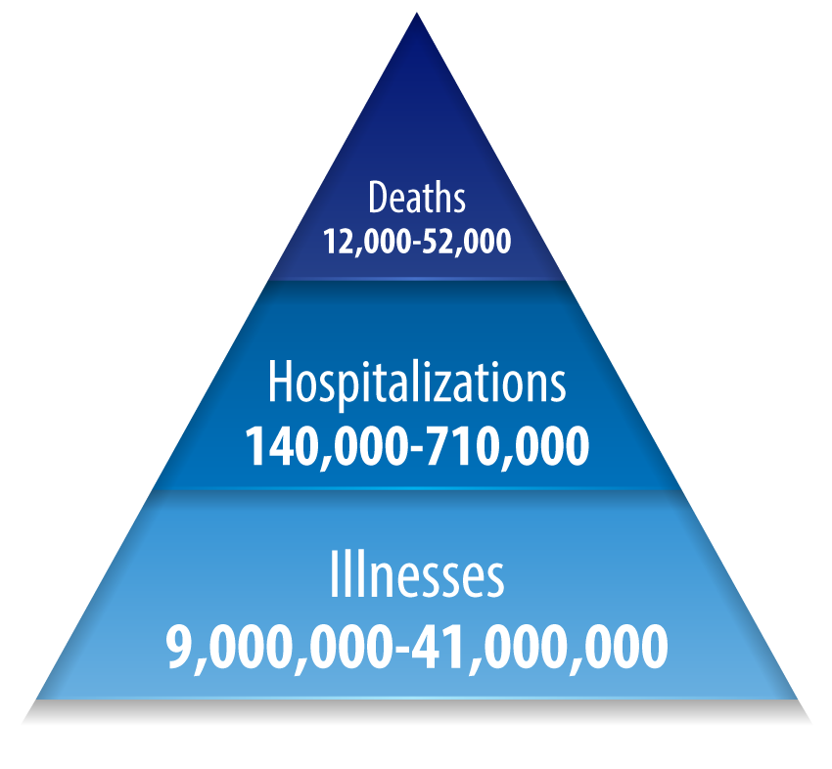
Flu
Every year in the U.S., flu causes:
Full name: influenza
Lung disease often with fever
Portion in those age 65+
  70-85% of deaths due to flu
  50-70% of hospitalizations
  due to flu
Notes:
Changing to a disease that you might be more familiar with, let's talk about flu. The full name is influenza.
The disease is primarily a disease of the lungs; as you know, it's often associated with fever, too.
The triangle shows that every year in the U.S., flu causes anywhere from 9 million to 41 million illnesses, 140,000 to 710,000 hospitalizations, and 12,000 to 52,000 deaths.
Why is flu vaccine important to our residents? Because 70-85% of deaths due to flu and 50-70% of hospitalizations due to flu are in people 65 or older.

Slide 25
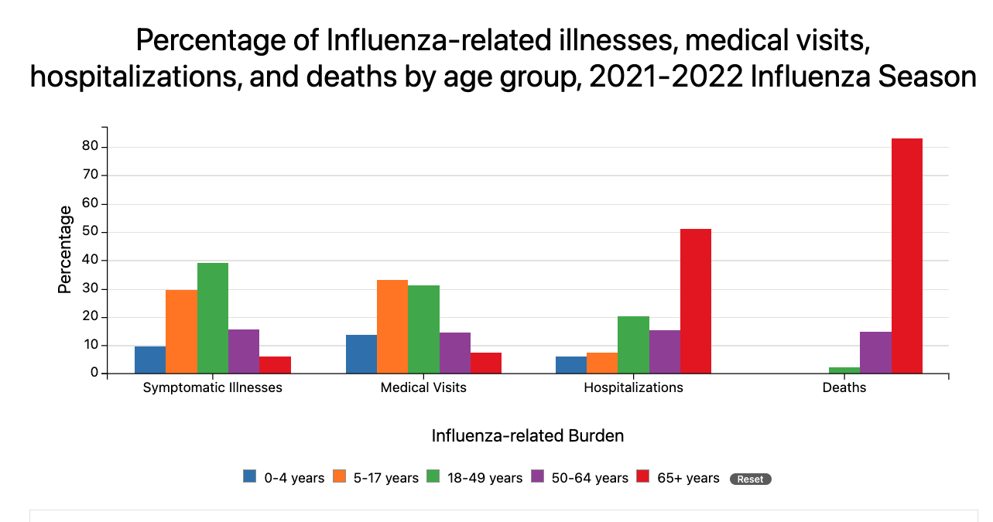
Notes:
This chart shows the percentage of people in each age group who have flu-related illness, medical visits, hospitalizations, and death.
People 65 and older are shown in red. You see that most of the hospitalizations and death from flu are in people 65 or older (the high red bars).
The flu vaccine is recommended for almost everyone six months of age and older because some people in all the age categories get flu serious enough to need a hospital stay.

Slide 26
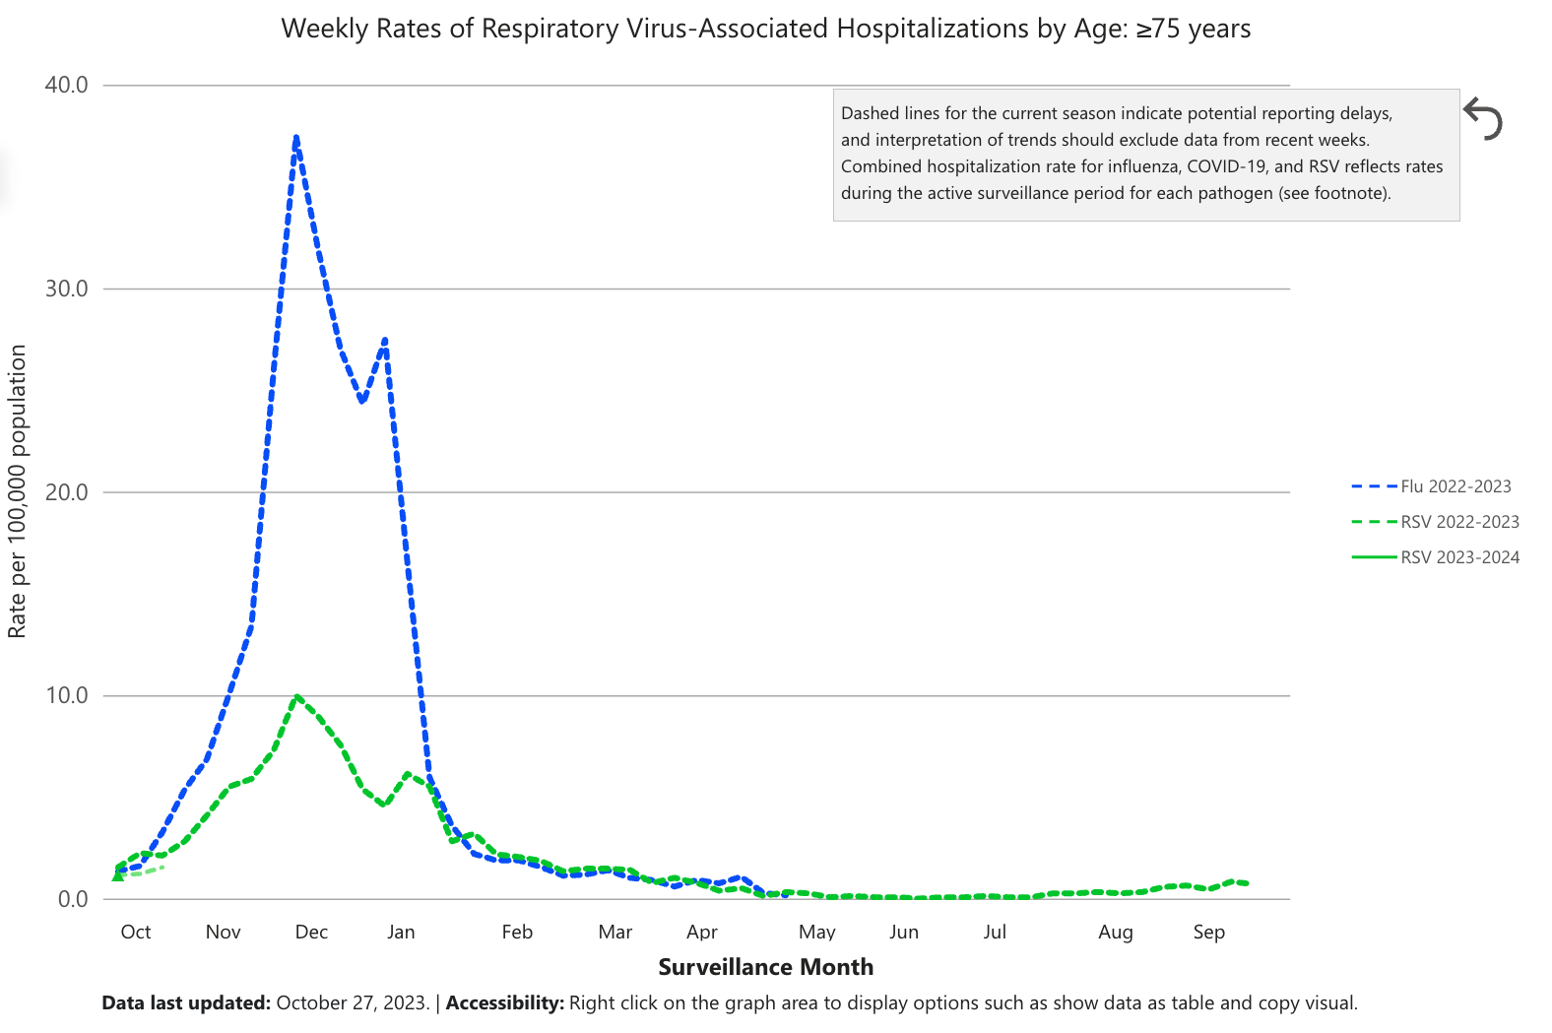
Weekly Rates of RSV and Flu Hospitalization (age 75+ years)
Flu
RSV
Notes:
This slide shows you the weekly rates of RSV and flu hospitalization in those age 75 and older.
You see that RSV and flu go up around the same time (in October) and are pretty much gone by the end of March.
There can be differences from year to year, but this is the normal pattern.
We know that both diseases can create challenges for our residents and if they are exposed to both, it can be harder for their immune systems to handle these two viruses.
We also know that emergency departments and hospitals are overwhelmed with sick older adults during this time period…one more reason to vaccinate!

Slide 27
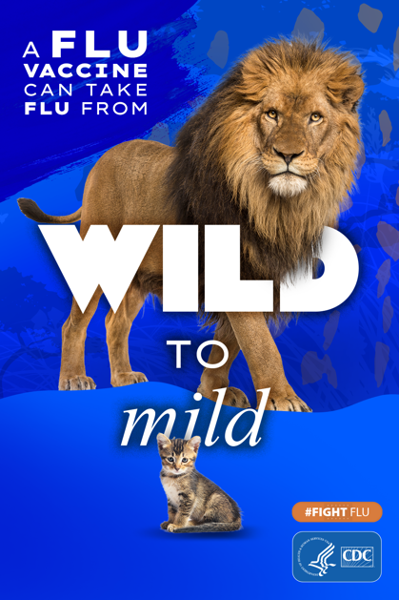
How effective is flu vaccine?
In 2022-2023 flu disease season, adults vaccinated against flu were
  44% less likely to visit an ED or urgent care
  39% less likely to be hospitalized
Vaccinated people who do get the flu usually have a milder case
Notes:
People often ask about “How effective is flu vaccine?”
It's different from year to year but during the 2022 to 2023 flu disease season, adults vaccinated against flu were 44% less likely to visit an emergency department or urgent care and 39% less likely to be hospitalized.
Overall, the flu vaccine reduces your risk of getting sick from flu by about 40%.
Vaccinated people who do get the flu usually have a milder case. That's why they say, “A flu vaccine can take flu from wild to mild.”

Slide 28
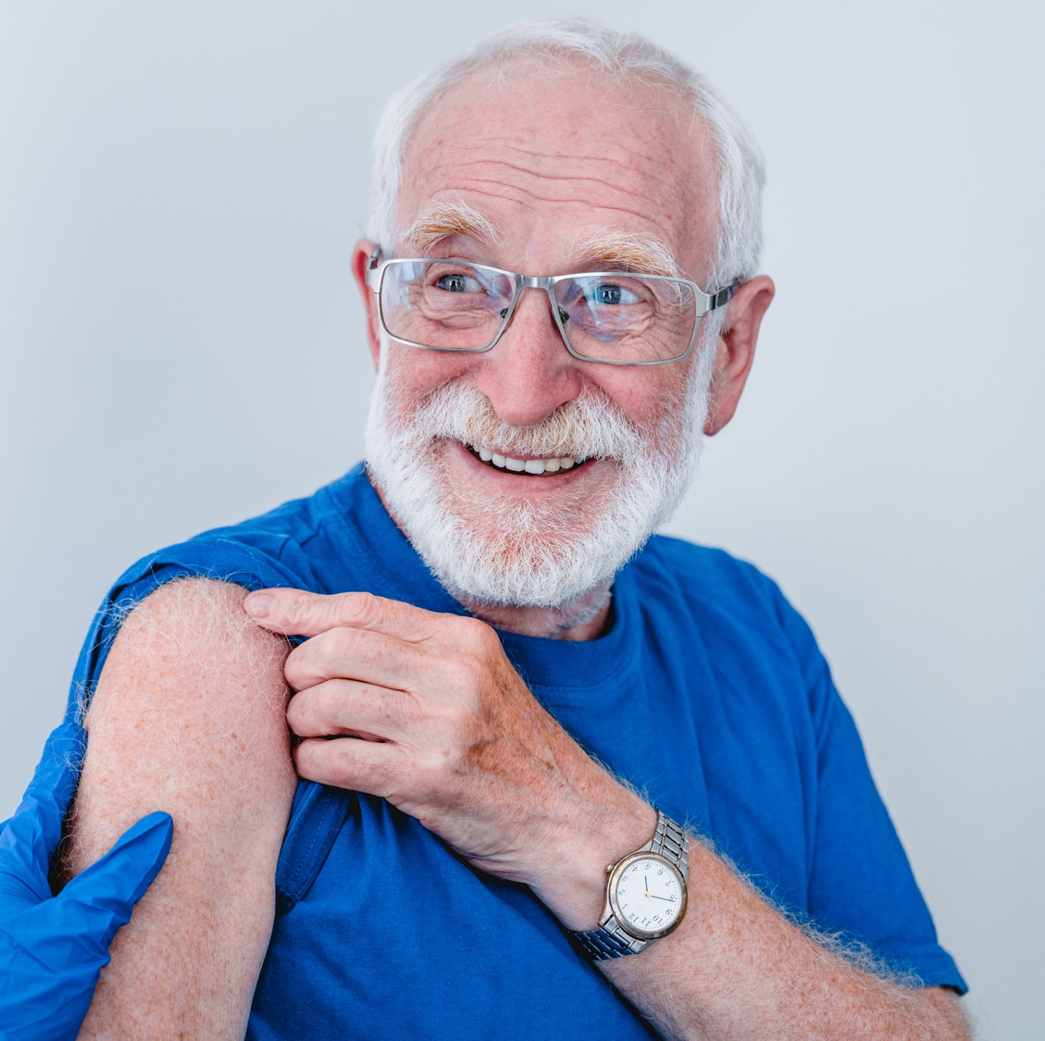
COVID-19
Full name: "coronavirus disease 2019"
Caused by virus called SARS-CoV-2
  Different "variants," or strains
  Some variants spread more easily or
  make people sicker than others
Early symptoms:
CAN YOU NAME SOME?
Notes:
Of course, when talking about diseases that affect older adults, we all think of COVID-19. The full name is "coronavirus disease 2019."
It’s caused by a virus called SARS-CoV-2 that has different "variants," or strains. We’ve seen that some variants spread more easily or make people sicker than others.
Now let’s talk about early symptoms – can you name some of these?
(SPEAKER NOTE: Give the participants a chance to answer.)

Slide 29
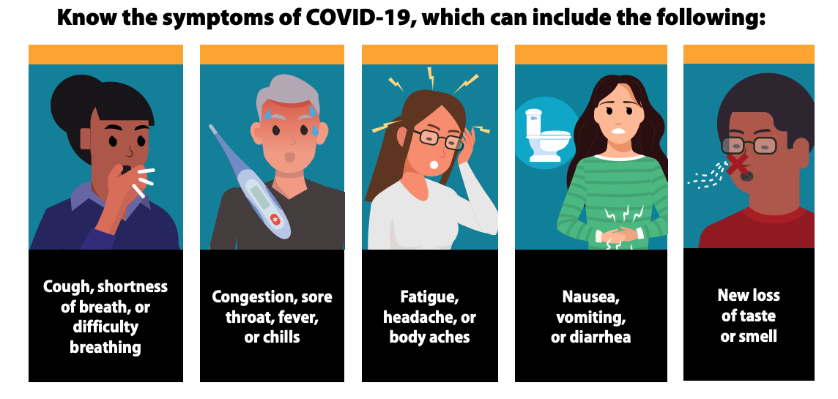
https://www.cdc.gov/coronavirus/2019-ncov/symptoms-testing/symptoms.html
Notes:
Early symptoms may include
Cough, trouble breathing
Congestion, sore throat, fever or chills
Feeling tired, headache, body aches
Nausea, vomiting of diarrhea
New loss of taste or smell

Slide 30
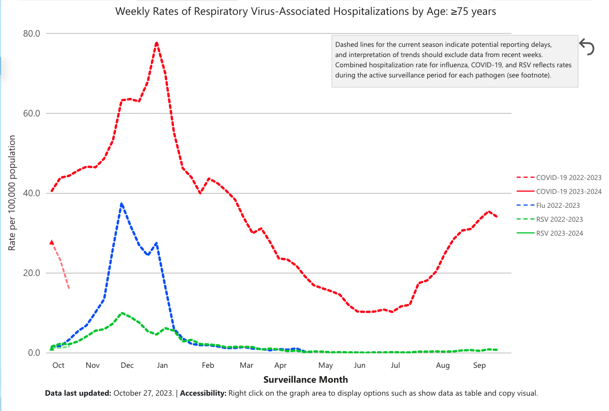
Weekly Rates of Hospitalization, 3 Viruses (age 75+ years)
COVID-19
Flu
RSV
October
2022
March
2023
Sept 2023
Notes:
This slide shows just how bad COVID-19 was in 2022 to 2023. Again, you're looking at the weekly rates of hospitalization for people 75 years of age or older.
COVID-19 caused almost twice as many hospitals stays as flu.
COVID-19 peaked a little bit later than flu and RSV, and hospitalization rates for COVID-19 remained higher every month throughout the whole year.
If all older adults – and everyone who has contact with older adults – were vaccinated, we couldn’t completely get rid of these diseases, but we could definitely decrease these hospitalization rates a good deal.

Slide 31
How effective is COVID-19 vaccine?
Three main factors of effectiveness
  More effective in people with stronger immune system
  If the virus changes, the vaccine’s effectiveness decreases
  “Effective against what?” Most vaccines are MORE effective against severe outcomes (e.g., needing a ventilator) than mild outcomes (having any symptoms)
Among adolescents & adults, bivalent vaccination reduced the chance
Of needing to go in for a medical visit for COVID-19 by 53%
Of needing to a hospital stay for COVID-19 by 58%
Of dying due to COVID-19 by 61%
For our residents, this is important because we want to minimize risk.
Notes:
COVID-19 is still causing some serious side effects in our older adults, although it’s better than before the vaccines so you may not see it as much. Our main form of prevention and protection is vaccination. Many of you might be thinking that you and the residents are still getting sick even after getting the vaccine, so how effective is it?
The effectiveness of a vaccine comes down to 3 main factors:
The vaccine is more effective in people with stronger immune system – so if YOU get the vaccine, it works better in you than in individual residents. (Of course, it’s best if both residents and staff get it.)
If the virus changes, the vaccine’s effectiveness decreases but may still provide some protection.
Also, it's important to ask, “Effective against what?” Most vaccines are MORE effective against severe outcomes (such as needing a ventilator) than mild outcomes (like having any symptoms).
For example, among adolescents & adults, bivalent vaccination reduced the chance
Of needing to go in for a medical visit for COVID-19 by 53%
Of needing to a hospital stay for COVID-19 by 58%
Of dying due to COVID-19 by 61%
For our residents, this is important because we want to minimize risk! We may see some people still getting sick even with vaccination, but the serious symptoms will be much less likely.

Slide 32


Why is the COVID-19 vaccine updated so much?
As the virus changes, the vaccine has to be updated, too. We have seen this with flu vaccine.
If you recently had COVID-19, you may consider delaying your vaccine by 3 months, but consider risk factors:
Personal risk of severe disease
Risk of disease in a loved one or close contact (residents)
Local COVID-19 hospital admission level:
www.cdc.gov/coronavirus/2019-ncov/your-health/covid-by-county.html
Notes:
So, this brings us to… why is the COVID-19 vaccine updated so much?
As the virus changes, the vaccine has to be updated, too. We have seen this with flu vaccine.
The updated COVID vaccine is designed to be effective against the newest variants. Will this be the last COVID-19 vaccine?
No one knows for sure, but it’s likely that the virus will keep changing. The updated vaccine updates protection against serious illness, hospital stays, and dying from COVID.
None of us want to go back to where we were in early 2022.
If you or a resident recently had COVID-19, you may consider delaying your vaccine by 3 months, but consider risk factors including:
Personal risk of severe disease
Risk of disease in a loved one or close contact (residents)
Local COVID-19 hospital admission level, which you can see on this website:
www.cdc.gov/coronavirus/2019-ncov/your-health/covid-by-county.html

Slide 33
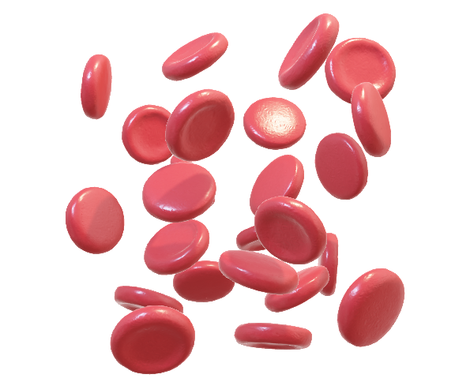

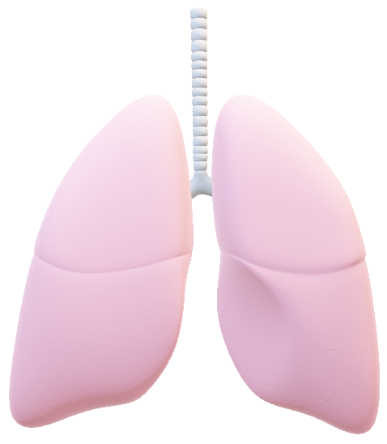
Strep Pneumonia Infections
(Streptococcal pneumoniae or “pneumococcus”)
Lungs Bloodstream Lining of brain & spinal cord
“Pneumonia” “Sepsis” “Meningitis”
Notes:
The next vaccine preventable disease we’ll talk about is strep pneumonia. The full name is streptococcal pneumoniae or “pneumococcus.”
The spread is like flu and COVID-19 from airway droplets.
The symptoms of pneumonia from pneumococcus are like flu and COVID, too – cough, fever, difficulty breathing.
Pneumococcus also can infect the bloodstream (that’s called “sepsis”) or the lining of the brain and spinal cord (that’s called “meningitis”).

Slide 34
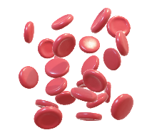
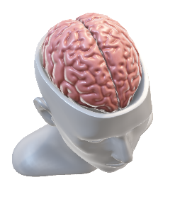
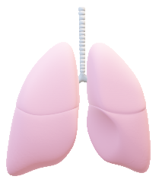
Consequences of pneumococcus infections each year in the U.S.
Pneumococcal pneumonia
  Causes 150,000 hospitalizations each year
  Among people with pneumococcal pneumonia, 5-7% die of it
Pneumococcal sepsis
  Causes 4,000 hospitalizations each year
  Among people with pneumococcal sepsis, 1-in-5 die of it (3-in-5 among older adults)
Pneumococcal meningitis
  Causes 2,000 hospitalizations each year
  Among adults with pneumococcal meningitis, 22% die of it even with proper treatment
  Those who survive may have lifelong disability including deafness, brain damage, and limb amputation
Notes:
The consequences of pneumococcus infections each year in the U.S. are quite bad.
Pneumococcal pneumonia causes 150,000 hospitalizations each year. Among people with pneumococcal pneumonia, 5-7% (about 1-in-20 ) die of it.
The death rate is even higher among adults aged 65 years and older and people with certain medical conditions.
Pneumococcal sepsis is worse but not as common. It causes 4,000 hospitalizations each year, but among people with pneumococcal sepsis, overall, 1-in-5 die of it. 3-in-5 older adults with pneumococcal sepsis die of it.
Pneumococcal meningitis causes 2,000 hospitalizations each year in the U.S. Among adults with pneumococcal meningitis, 22% die of it even with proper treatment. Those who survive may have lifelong disability including deafness, brain damage, and limb amputation.
These serious consequences are why the pneumococcal vaccine has long been recommended for all people aged 65 years or older.
SPEAKER NOTE: In case you want the reference, here it is:
See CDC “Pneumococcal Disease: Clinical Features”
https://www.cdc.gov/pneumococcal/clinicians/clinical-features.html

Slide 35







Even if an older adult had pneumococcal vaccine in the past, it may be that their healthcare provider recommends one of the
updated, expanded vaccines for them.
Notes:
There are more than 80 types of pneumococci that our immune systems see as different depending on the outer coat.
In the year 2000, a vaccine was licensed that addressed the 7 most common types.
Then in 2010, a vaccine was licensed that addressed the 13 most common types.
In recent years, vaccines against more types have been licensed.
Even if an older adult had pneumococcal vaccine in the past, it may be that their healthcare provider recommends one of the updated, expanded vaccines for them.

Slide 36
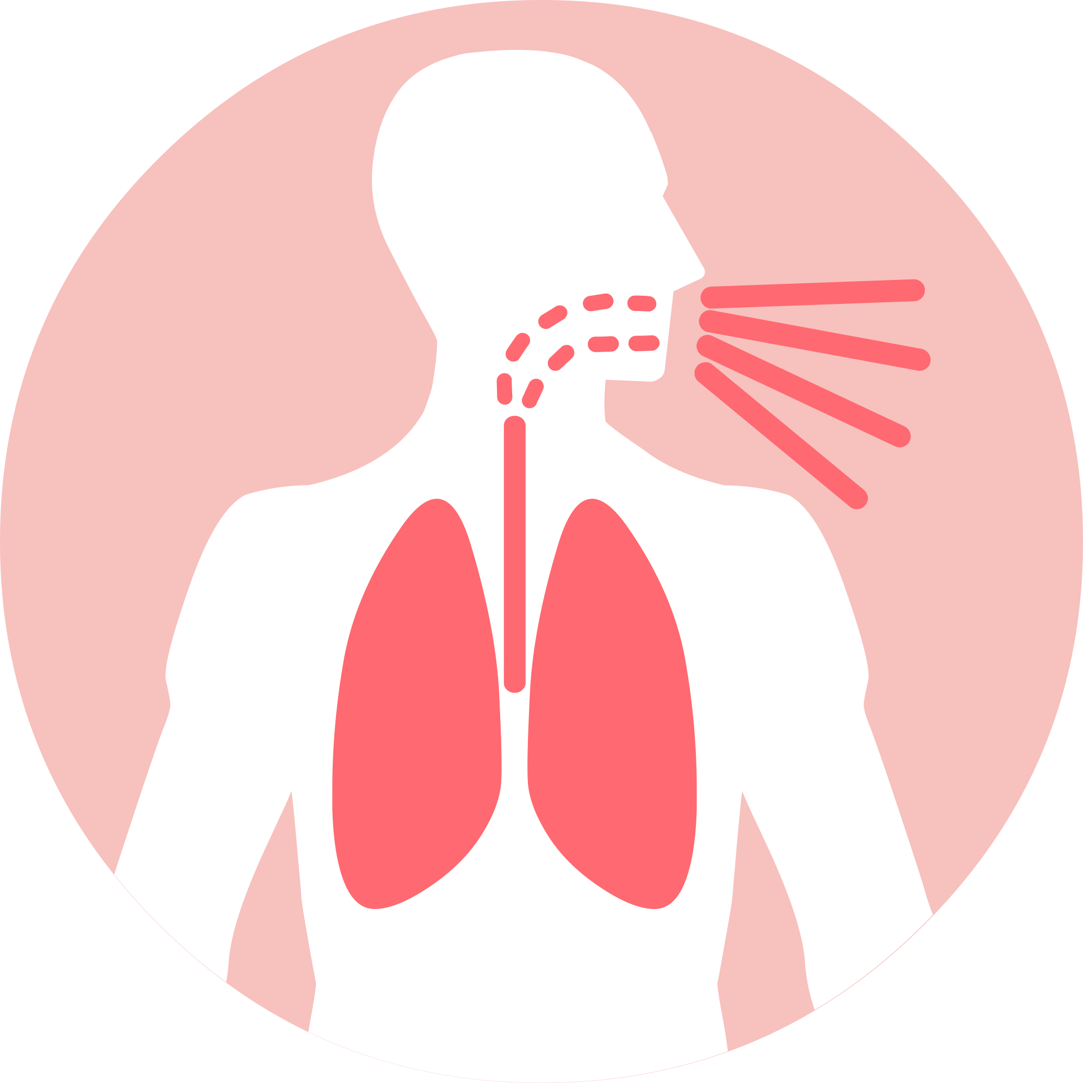
Tdap
Full name: tetanus, diphtheria, and pertussis vaccine
Tetanus=lock jaw; diphtheria=blocks airway; pertussis=whooping cough
Routine: one dose of Tdap every 10 years
Residents are at increased risk of
pertussis transmission if there is an outbreak
Notes:
I mentioned the vaccine called T-DAP. It works against tetanus (also known as lockjaw), diphtheria, and pertussis (also known as whooping cough).
This vaccine has been routine for a long time and serves as a booster for your childhood DTaP vaccine. From preteens on up, people are routinely recommended to get one dose every 10 years.
This is one that your health professional may recommend for you, but you are not more at risk of getting tetanus, diphtheria, or especially pertussis in a long-term care environment than out in the community. However, residents are at increased risk of pertussis transmission if there is an outbreak because they live in close quarters.

Slide 37
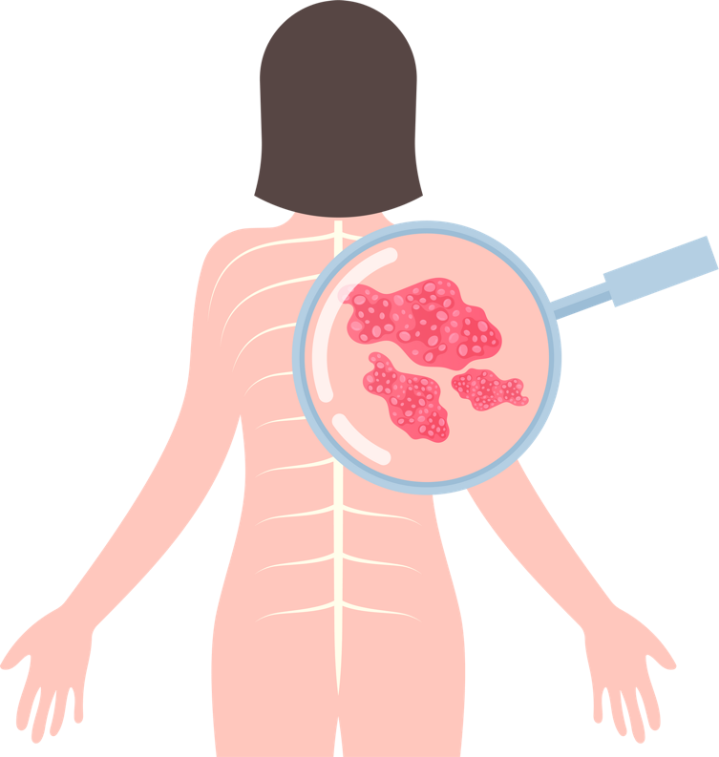
Shingles (Zoster)
How do we get shingles? After chickenpox, the virus lives on in the body
Severe effects of shingles disease
  “PHN” = burning pain in nerves & skin for more than 30 days; most common complication of shingles; the pain can last long after the rash resolves
  May damage the eye (vision loss)
  Other effects (hearing loss, brain inflammation) are rare
Notes:
The last disease we’ll talk about preventing in residents is shingles (also known as zoster).
Shingles usually starts as chickenpox when we’re young. After chickenpox, the virus lives on in the body, in the nerve cells.
There can be some severe effects of shingles disease.
“PHN” is a burning pain in nerves & skin for more than 30 days; it’s the most common complication of shingles. The pain can last months or even years after the rash resolves.
Shingles also may damage the eye & cause vision loss.
Rarely, shingles disease causes hearing loss or brain inflammation.

Slide 38
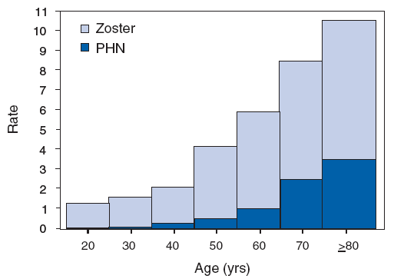
The risk of shingles & PHN increase with age
per 1,000-person years
Who should receive this vaccine:
  All adults aged 50+ years
  Adults who are or will be immunodeficient or immunosuppressed
Schedule (2 doses)
  Typically, 2nd given 2–6 months after 1st first
  This interval can be a shorter for immunosuppressed adults
Notes:
This graph shows how the risk of developing shingles (shown in the light blue bars) goes up with each decade of life.
PHN (the severe pain, shown in the dark blue bars) increases with age, too. Because these risks increase with age, the vaccine is recommended for people aged 50 or older.
Also, it’s recommended for adults who are OR will be immunodeficient or immunosuppressed because of disease or therapy. When possible, they should be vaccinated before they are immunosuppressed.
The schedule is for 2 doses.
Typically, the second dose is given 2 to 6 months after the first, but this interval can be a shorter for immunosuppressed adults.

Slide 39
Discussion point:
Do any of you have experience with someone who had any of the diseases that can be prevented by vaccines?
Notes:
Do any of you have experience with someone who had any of the diseases that can be prevented by vaccines?
SPEAKER NOTE: Give time to discuss

Slide 40
What vaccines are recommended for people who work with older adults?
Notes:
We’ve talked about vaccines for older adults – what about vaccines recommended for people who work with older adults?

Slide 41
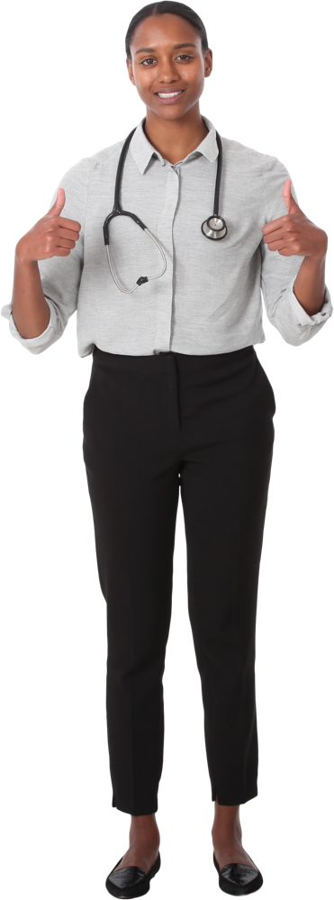
Your doctor may recommend for you to get vaccines not discussed today.
Three of the vaccines we’ve discussed are routine for all adults:
  Flu (once each year)
  COVID-19 (as the virus changes)
  Tdap (once every 10 years)
  (No RSV vaccine until age 60, unless pregnant)
Today, we’ll focus just on ones that are most important to your work environment.
Notes:
Your doctor may recommend for you to get vaccines not discussed today based on personal health factors.
Three of the vaccines we’ve discussed are routine for all adults:
Flu (given once each year)
COVID-19 (updates given as the virus changes)
Tdap (given once every 10 years)
(No RSV vaccine is licensed until age 60, unless you’re pregnant.)
Today, we’ll focus just on ones that you are most at risk for because of your work environment.

Slide 42
Discussion point:
Why are flu & COVID-19 vaccines especially important for people who work in a medical setting with older adults?
Notes:
Let’s take a minute to talk about: Why are flu & COVID-19 vaccines especially important for people who work closely with older adults?
SPEAKER NOTES:
Points that may come up:
Many people living in close quarters
Residents (who have relatively weaker immune systems) are more likely to get sick
Because we are in close contact for long periods with sick people (who need MORE care), we get exposed

Slide 43
We are at special risk of becoming infected because of working in long-term care!
The people we care for are at special risk if they do become infected!
Notes:
We are at special risk of being exposed to the viruses that cause flu and COVID-19 because of working in long-term care.
Also, the people we care for are at special risk if they do become infected!
So, this is why staff should get vaccinated, too.
Of course, we don’t want to bring home these diseases to our loved ones.
GRAPHIC FROM https://phil.cdc.gov/Details.aspx?pid=11160

Slide 44
Another reason to get COVID-19 vaccine:
Prevent Long COVID-19
Other names: Post-COVID Condition, Long-Haul COVID, many others
What? Wide range of conditions such as chronic pain, “brain fog”, shortness of breath, chest pain, and intense fatigue
How severe? Ranges from mild to debilitating
When? Can be persistent, recurrent, or new
How long? May last for weeks, months, or years
How common? Now about 1-in-10 people who had COVID-19
(used be about 1-in-5)
Who is at risk of Long COVID? Can affect anyone of any age whether their initial symptoms were nothing, mild, or severe COVID-19.
Vaccination reduces your risk of getting Long COVID
Notes:
Another reason to get COVID-19 vaccine is to prevent Long COVID. Some of you may have experienced it. And many of you may have escaped it by getting the COVID vaccine.
Long COVID goes by a lot of different names including post COVID condition, long haul covid, and many others.
It's a wide range of conditions such as chronic pain, brain fog, shortness of breath, chest pain, and intense fatigue.
The severity ranges from mild to debilitating.
Symptoms can be persistent (sticking with a person even after they test negative), recurrent (showing up after the person’s been test negative for a while), or new.
Long COVID may last for weeks, months, or years.
With the current virus, about 1-in-10 infected people get Long COVID (it used to be about 1-in-5).
Long COVID can affect anyone of any age whether their initial COVID symptoms were nothing, mild, or severe.
It’s important to know that people who are vaccinated are less likely to get long COVID.
Residents are at risk too - I don't mind this here but think we may need to reframe a little.

Slide 45
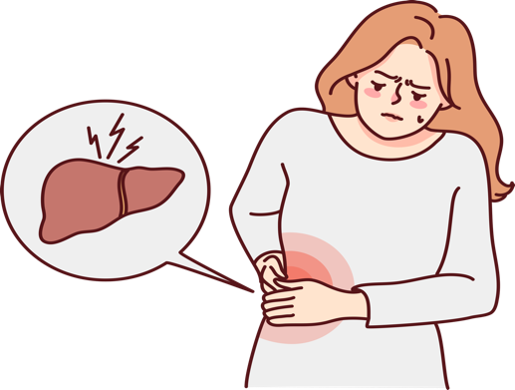
Hepatitis B
The most common serious liver infection
in the world
Hepatitis B virus (HBV) attacks liver cells and can lead to liver failure, cirrhosis (scarring), or liver cancer later in life
Spread through direct contact with infected blood and bodily fluids, and from an infected woman to her newborn at birth
Vaccination is recommended for:
  All healthcare workers
  Everyone younger than age 60 years
  People 60+ years who want this protection, especially if at higher risk
Notes:
One vaccine that is routinely recommended for younger adults, but not always older adults is Hepatitis B vaccine.
Hepatitis B is the most common serious liver infection in the world.
The virus attacks liver cells and can lead to liver failure, cirrhosis (scarring), or liver cancer later in life.
Hepatitis B virus is spread through direct contact with infected blood and bodily fluids, and from an infected woman to her newborn at birth.
Hepatitis B vaccination is recommended for:
All healthcare workers, It’s especially important if there is any chance at all of an accidental needle stick …whether you’re giving injections or cleaning a room where an injection was given.
Everyone younger than age 60 years
People older than age 60 years who want this protection, especially if at higher risk

Slide 46
Frequently asked questions
Notes:
Before we wrap up, let’s talk about some of the frequently asked questions about vaccination.

Slide 47
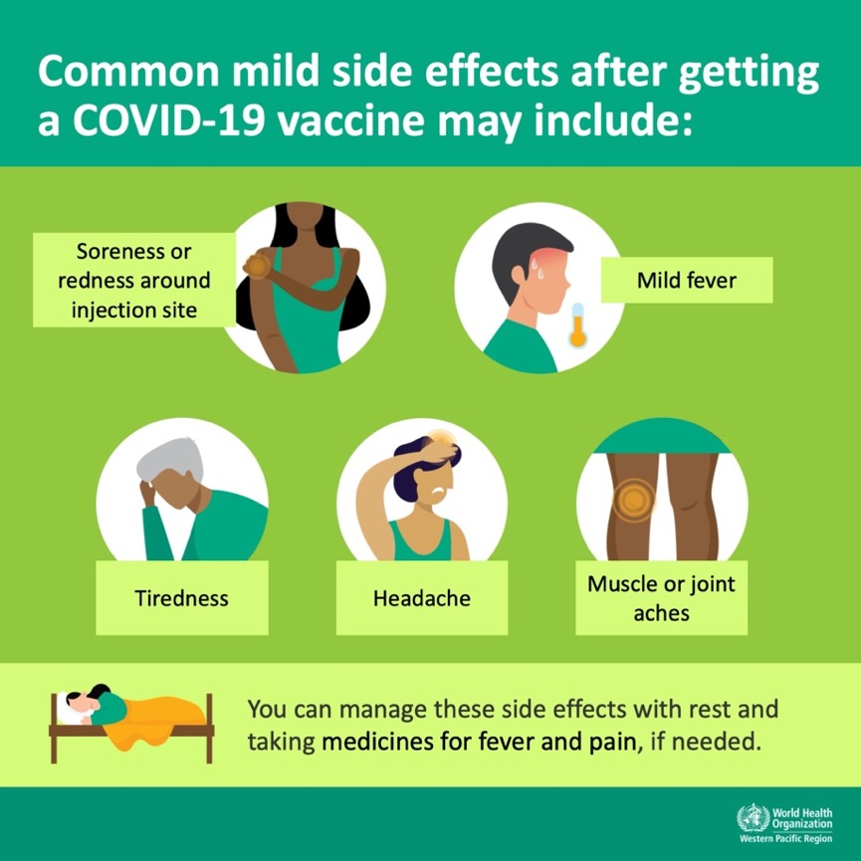
What are the most common side effects to vaccines?
Tend to be a sign of a strong immune system, so these side effects tend to be less common in older adults
Fainting is common after any needle stick, so have patients sitting or lying down before, during, and for 15 minutes after vaccination.
Notes:
First - What are the most common side effects to vaccines?
We need to know this because residents (as well as our families and we ourselves) may have these side effects after getting a vaccine.
Common side effects after getting pretty much any injected vaccine include soreness or redness around the injection site, mild fever, tiredness, possibly a headache, or even muscle or joint aches.
You can manage these side effects with rest and taking medications such as ibuprofen or acetaminophen for fever and pain, if needed.
These side effects tend to be a sign of a strong immune system, so they tend to be less common in older adults.
ALSO - Fainting is common after any needle stick, so it's wise to have anyone receiving the vaccine sitting or lying down before, during, and for 15 minutes after vaccination.

Slide 48
What is the most common serious side effect to vaccination?
Notes:
What is the most common serious side effect to vaccination?

Slide 49
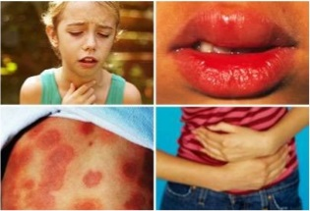
Allergic reaction is the most common serious side effect to vaccination
How common?
  1.31 per 1,000,000 doses
  for all vaccines
  1.35 per 1,000,000 doses
  for flu vaccines
The person may be treated with a shot of epinephrine.
Photos from King County Medic One
Notes:
Allergic reaction is the most common serious side effect to vaccination.
A serious allergic reaction occurs rarely…
1.31 per million doses for all vaccines
1.35 per million doses for flu vaccines
The person may be treated with a shot of epinephrine.

Slide 50
What are the serious side effects to flu and COVID vaccines?
Notes:
What are the serious side effects to flu and COVID vaccines?

Slide 51
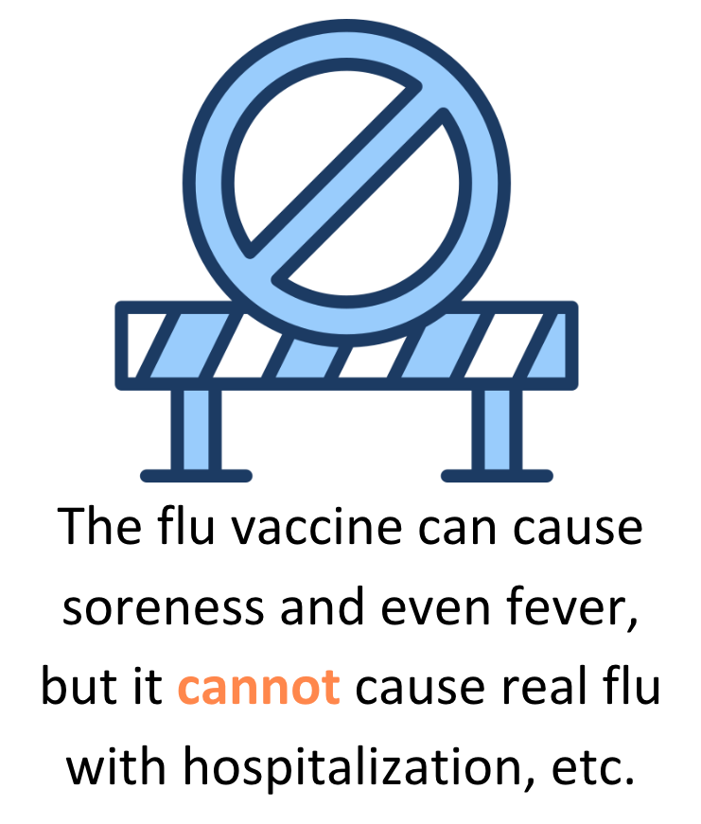
Possible serious side effect: Flu vaccine
Guillain-Barre Syndrome (GBS)
Damage to nerves
Usually goes away on its own, but may persist
0 to 2 cases after each 1,000,000 doses of flu shot
(not after nose spray)
Almost 5 times more common after natural flu disease than after flu shot
Notes:
There is a rare, serious potential side effect to flu vaccine. It’s called Guillain-Barre Syndrome or G.B.S.
It’s damage to nerve cells caused by the person’s immune system.
It usually goes away on its own, but it may persist.
There are between 0 to 2 cases after each million doses of flu shot. It is not known to be caused by the nose spray flu vaccine.
GBS is almost 5 times more common after natural flu disease than after flu shot.
Another thing I want to get out there: The flu vaccine can cause soreness and even fever, but it cannot cause real flu with hospitalization, et cetera.
SPEAKER NOTE: Here is the reference
https://www.ncbi.nlm.nih.gov/pmc/articles/PMC6985921/

Slide 52
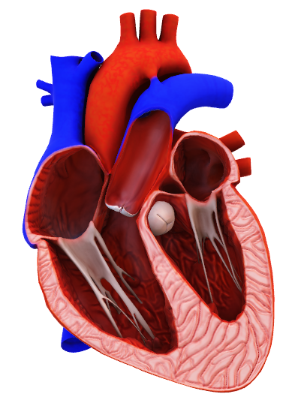
Possible serious side effects: COVID-19 vaccine
Definitions: myocarditis -- inflamed heart muscle;
pericarditis -- inflamed sack that surrounds the heart
People are more likely to have these conditions after being infected with the COVID-19 virus than after COVID vaccine
Most patients who developed one of these conditions after COVID-19 vaccination felt better quickly with medicine and rest
For every 1 million vaccine doses there are about 50-100 cases of these heart conditions in adolescent males (the highest risk group).
Notes:
Possible serious side effects to COVID-19 vaccine include myocarditis (meaning inflamed heart muscle) and pericarditis (meaning inflammation of the sack that surrounds the heart).
People are more likely to have these conditions after being infected with the COVID-19 virus than after COVID vaccine.
Most patients who developed one of these conditions after COVID-19 vaccination felt better quickly with medicine and rest.
For every 1 million vaccine doses there are about 50 to100 cases of these heart conditions in adolescent males (the highest risk group).

Slide 53
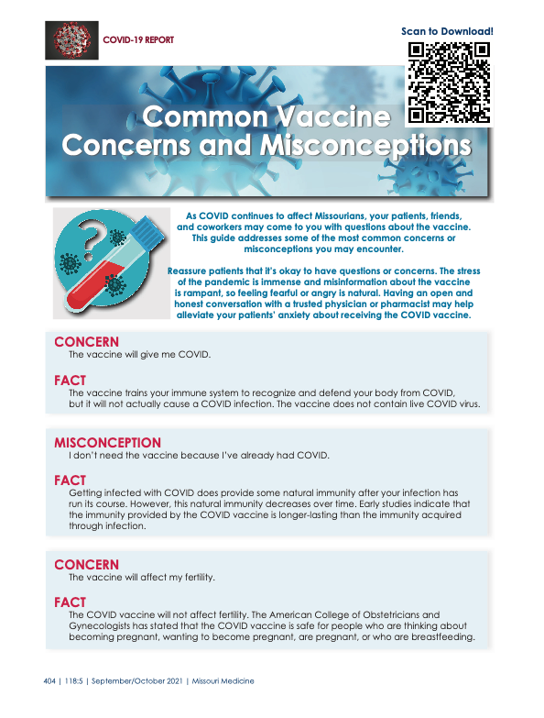

Answers to common concerns about COVID vaccines?
https://www.ncbi.nlm.nih.gov/pmc/articles/PMC8504505/
Notes:
For even more information about common concerns of COVID vaccines you may want the great reference shown on this slide.
https://www.ncbi.nlm.nih.gov/pmc/articles/PMC8504505/
SPEAKER NOTE: If you want to download the sheet, here is the link to the pdf:
https://www.ncbi.nlm.nih.gov/pmc/articles/PMC8504505/pdf/ms118_p0404.pdf

Slide 54

Are the vaccine benefits worth the side effects?
Side Effects
It’s normal to experience some mild side effects after getting a vaccine
Reactions to vaccines can vary depending on your age, which vaccine you got, and how many doses you have received
Treat them with over-the-counter medicine (e.g., acetaminophen)
Benefits of Vaccination
Lowers your risk: People who have been fully vaccinated are less likely to get sick or have disease complications (be severely ill, be hospitalized, or die)
Decrease spread: Vaccinated people are less likely to spread the virus
Notes:
Some people ask, “Are the vaccine benefits worth the side effects?”
It’s normal to experience some mild side effects after getting a dose of the COVID-19 vaccine.
Reactions to vaccines can vary depending on your age, which vaccine you got, and how many doses you have received.
You can treat these side effects with over-the-counter medicine (e.g., acetaminophen)
Even though vaccines are not 100% effective, there are tremendous benefits to vaccination:
Vaccination lowers your risk: People who have been fully vaccinated are less likely to get sick or have disease complications (such as being severely ill, being hospitalized, or dying)
Plus, vaccinated people are less likely to spread the virus
The balance is significantly in favor of vaccination, especially for viruses that are spread in the air.

Slide 55

Will vaccines harm my fertility?
No. There is no evidence that any vaccines, including
COVID-19 vaccines, cause fertility problems in females or males.
Female fertility: A study done by the American Society for Reproductive Medicine showed women who had the COVID-19 vaccines were able to get pregnant at the same rates as women who did not get the vaccines.
Male fertility: Sperm characteristics (like quantity and movement) before and after vaccination are not changed.
The CDC, American College of Obstetricians and Gynecologists , and American Academy of Pediatricians have all confirmed:
COVID-19 vaccines do not affect fertility.
Notes:
A question that social media poses with every new vaccine is, “Will vaccines harm my fertility?”
No. There is no evidence that any vaccines, including COVID-19 vaccines, cause fertility problems in females or males. This slide shows some of the specific studies done about COVID-19 vaccine and fertility.
Regarding female fertility: A study done by the American Society for Reproductive Medicine showed women who had the COVID-19 vaccines were able to get pregnant at the same rates as women who did not get the vaccines.
Regarding male fertility: Sperm characteristics (like quantity and movement) before and after vaccination are not changed.
The experts in public health -- CDC, and doctors of the American College of Obstetricians and Gynecologists and American Academy of Pediatricians (AAP) all confirmed that COVID-19 vaccines do not affect fertility.

Slide 56
Helping to make sure residents are vaccinated
Notes:
All right. We've talked about the importance of protecting residents through direct vaccination and vaccination of staff. How can we help to make sure residents themselves are vaccinated?

Slide 57






ASSESS vaccination status of all residents in every clinical encounter
SHARE a strong recommendation for vaccines that residents need
ADMINISTER needed vaccines or
REFER to a provider who can vaccinate
DOCUMENT vaccines administered or received by residents
Notes:
Here are recommended approaches:
ASSESS vaccination status of all residents in every clinical encounter
SHARE a strong recommendation for vaccines that residents need
ADMINISTER needed vaccines or REFER to a provider who can vaccinate
DOCUMENT vaccines administered or received by residents

Slide 58

All healthcare professionals --
including workers in long-term care settings --should take these steps to ensure that adult patients are fully vaccinated and have maximum protection from serious diseases.
Notes:
According to the National Vaccine Advisory Committee, all healthcare professionals
--including workers in long-term care settings --
should take these steps to ensure that adult patients are fully vaccinated and have maximum protection from serious diseases.

Slide 59
Discussion point:
What are your suggestions for making sure our residents are vaccinated?
Notes:
What are your suggestions for making sure our residents are vaccinated?

Slide 60
Information specific to our workplace
Notes:
OK, to wrap up let's talk about information specific to our workplace.
SPEAKER NOTE:: Here please add information that is relevant to your workplace such as how staff can get vaccinated at no cost, who they should turn to with questions, etc.
The next few slides are blank so that you can add additional information as needed.

Slide 61
Information specific to our site
Vaccination clinic dates and time:
Contact person:
Other
Notes:
Information specific to our site
Vaccination clinic dates and time:
Contact person:
Other

Slide 62
Please complete the evaluation of this session
Notes:
Please complete the evaluation of this session.
SPEAKER NOTE: Please describe how to complete the evaluation (e.g., paper, online)

Slide 63

Thank you for your attention!
Any questions?
Notes:
Thank you for your attention! Any questions?

